Slide 1
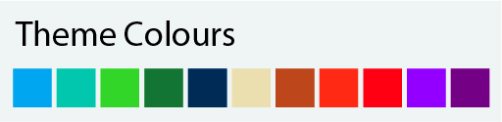
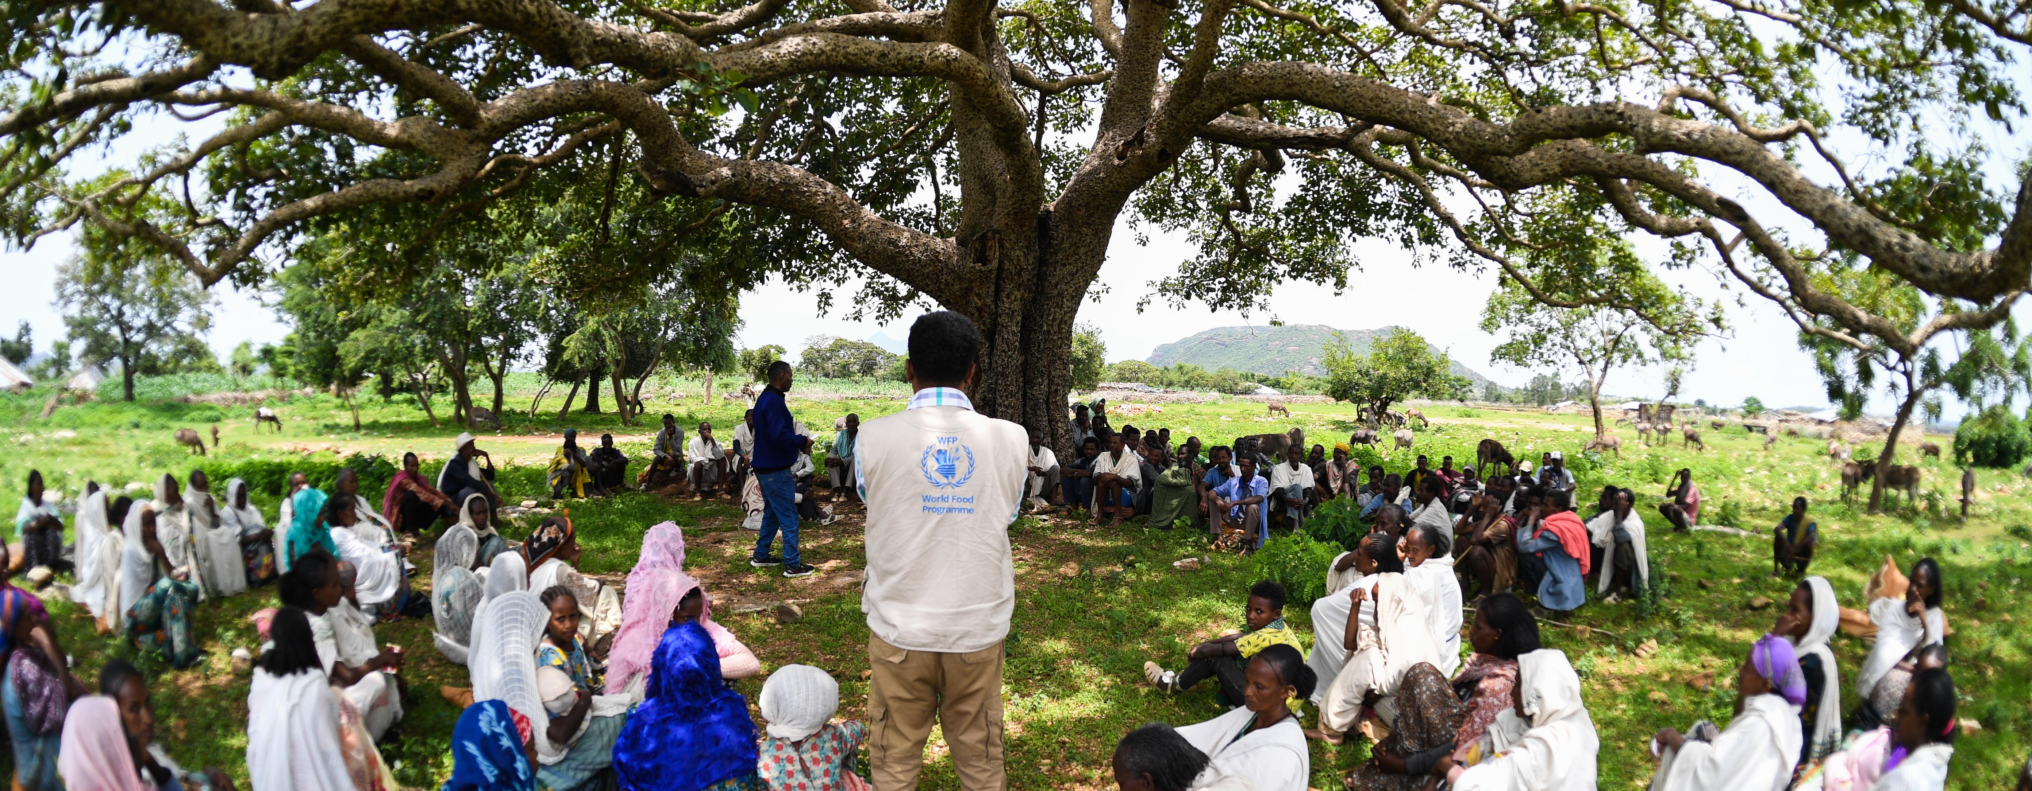

Targeting Strategy Interviews
Template interview questions
©WFP/Michael Tewelde
Date

Slide 2
Note: free to change the colours to any of the WFP Corporate colours (see box to the left).
Questions we are aiming to answer through interviews
Background and CSP Overview
In which context are WFP programmes implemented?
Programmatic Objectives
What vulnerability framework does each programme use?
Partnerships
How do programmes from partners interact with WFP’s?
Can targeting build on synergies in vulnerability frameworks?
Coordination Mechanisms
Which coordination mechanism (internal/external) will be used to ensure decisions are in line with the strategy?
Step 1: Needs and Context Analysis (high-level)
Which data will be used to design and update the targeting?
Step 2: Targeting Design (high-level)
Which targeting method seems most appropriate (per programme/activity)?
How will we engage with communities for the design?
Step 3: Implementation (high-level)
How will we register and verify beneficiaries for our programmes?
How will we engage with communities (CFM, appeals)?
Step 4: Monitoring (high-level)
How will we monitor targeting errors and targeting risks?
Targeting Risk Management
Who are the stakeholders interested in our targeting decisions?
What are the risks around the proposed targeting approaches?
Targeting Assurance Roadmap
Which improvements will need to be integrated to our current targeting?

Slide 3
Needs and vulnerability assessment
Across the process: Community engagement, CFM and communication
0
Analysis of programme objectives, budgets, targeting risks and lessons learned
1.1
Identification of vulnerability framework
1.2
Assessment (geographical and household level) and analysis
Targeting Design
2
Deciding whether targeting is appropriate
3
Selecting the targeting methodology
4
Identification of eligibility criteria
5
Validating the targeting methods and criteria
Targeting Implementation
6
Implementation of the appeal mechanism
7.1
Identification/profiling of beneficiaries
7.2
Verification of beneficiaries and communication of beneficiary status
7.3
Registration of beneficiaries (SCOPE)
Targeting Monitoring
8
Monitoring

Slide 4
Needs and vulnerability assessment
0
Analysis of programme objectives, budgets, targeting risks and lessons learned
[Add questions on programme objectives and linkages across CSP]
[Add questions linked to risks, including conflict-sensitivity and protection]
[Add questions related to budget and potential funding cuts]

Slide 5
Needs and vulnerability assessment
1.1
Identification of vulnerability framework
[Add questions on existing vulnerability framework for geographic vs. household targeting]
[Add questions on linkages with vulnerability framework of other programmes/activities of the CSP]

Slide 6
Needs and vulnerability assessment
1.2
Assessment (geographical and household level) and analysis
[Add questions on available evidence sources (WFP and external) linked to the vulnerability framework]
[Add questions on the assessments normally performed and their past usefulness in driving targeting for this programme/activity]

Slide 7
Targeting Design
2
Deciding whether targeting is appropriate
[Add questions on the homogeneity/heterogeneity of vulnerability in the programmatic context]
[Add questions on linkages possible between targeting for this programme/activity vs. other WFP’s or partners’ programmes/activities]

Slide 8
Targeting Design
3
Selecting the targeting methodology
[Add questions on the risks of the various methods in the context]
[Add questions on the feasibility of the various methods in the context]
[Add questions on the community acceptance of the various methods in the context]
[Add questions on how the approach would need to be adapted for prioritization]
Blanket Assistance
Geographic Targeting
Status-based Targeting
Self-enrollment
Community Driven Targeting
Community Based
Categorical
Data-Driven Targeting
Scorecard
PMT

Slide 9
Targeting Design
4
Identification of eligibility criteria
[Add questions on previous eligibility criteria and how they were determined]
[Add questions on their relevance in the context (e.g., what does the CFM and appeal say)]
[Add questions on how eligibility criteria at a geographic and/or household level could foster integrated programming]
[Add questions on how the process to identify eligibility criteria could limit risks of undue influence]
DRAFT – NOT FOR CIRCULATION

Slide 10
Targeting Design
5
Validating the targeting methods and criteria
[Add questions on stakeholders and community engagements done in the past to validate the method and criteria]
[Add questions on key stakeholders to involve moving forward]
DRAFT – NOT FOR CIRCULATION

Slide 11
Targeting Implementation
6
Implementation of the appeal mechanism
[Add questions on the existing appeal mechanism (i.e., ability of a community member to request a review of its eligibility status and potentially be included in caseload)]
[Add questions on the capacity of CFM or other channels to be used as appeal mechanism]
[Add questions on the use of appeal data to modify future targeting]
[Add questions on the ability of appeals to trigger changes in eligibility, and potential changes required to communication and IDM processes in place]
DRAFT – NOT FOR CIRCULATION

Slide 12
Targeting Implementation
7.1
Identification/profiling of beneficiaries
[Add questions on the existing process to identify beneficiaries meeting the eligibility criteria]
[Add questions on the communication process used during identification]
DRAFT – NOT FOR CIRCULATION

Slide 13
Targeting Implementation
7.2
Verification of beneficiaries and communication of beneficiary status
[Add questions on the verification in place to check that identified beneficiaries respect eligibility criteria and are vulnerable]
[Add questions on channels used to communicate beneficiary status (eligible vs. non-eligible) to each beneficiary and the community]
[Add questions on the effectiveness of the current process and conflict/protection risks identified]
DRAFT – NOT FOR CIRCULATION

Slide 14
Targeting Implementation
7.3
Registration of beneficiaries (e.g., SCOPE)
[Add questions on IDM systems used to register beneficiaries]
[Add questions on interoperability with partners and across programmes/activities]
[Add questions on adaptability in case of funding cuts]
DRAFT – NOT FOR CIRCULATION

Slide 15
Targeting Monitoring
8
Monitoring
[Add questions on how to adapt the sampling framework for monitoring to enable monitoring of targeting effectiveness and targeting errors]
[Add questions on the triangulation of monitoring, CFM and appeal data for targeting improvements]
[Add questions on monitoring timing vs. usefulness for targeting adjustments]
[Add questions on existing monitoring or CFM results linked to targeting]
DRAFT – NOT FOR CIRCULATION

Slide 16
Cross-Cutting: Communication and AAP
[Add questions on community engagement process and channels (FGDs during assessments, validation of targeting methods and criteria, communication of beneficiary lists, etc.)]
[Add questions on how communication function can support community engagement and acceptance]
DRAFT – NOT FOR CIRCULATION

Slide 17
Cross-Cutting: CFM
[Add questions on CFM’s insights on targeting]
[Add questions on CFM operators’ knowledge of the targeting approaches across programmes/activities]
[Add questions on escalation mechanisms for risks of undue influence]
DRAFT – NOT FOR CIRCULATION

Slide 18
Cross-Cutting: Partnerships
[Add questions on the management of donors/partners request impacting the targeting]
[Add questions on acceptance of funds that are not aligned to the targeting strategy (e.g., donors asking for a geographic area that is not priority)]
[Add questions on stakeholders to proactively engage in targeting strategy elaboration to maximize impact]
DRAFT – NOT FOR CIRCULATION

Slide 19
Cross-Cutting: CP Management
[Add questions on the skills mapping and capacity building efforts of partners engaged in targeting]
[Add questions on segregation of duty]
DRAFT – NOT FOR CIRCULATION

Slide 20
Cross-Cutting: Gender and Protection
[Add questions on what could be improved to promote inclusion and limit protection risks in the targeting]
[Add questions on segregation of duty]
DRAFT – NOT FOR CIRCULATION

Slide 21
Cross-Cutting: TEC/IDM
[Add questions on checks in place to ensure those targeted are the ones assisted]
[Add questions on beneficiary data protection when WFP is in the lead vs. WFP targeting is managed by partners/other agencies (e.g., joint programmes)]
[Add questions on the data update and deduplication cycles to ensure data registered is as accurate as possible]
[Add questions on segregation of duty]
DRAFT – NOT FOR CIRCULATION

Slide 22
Cross-Cutting: Field/Sub Offices
[Add questions on any process that is adapted to fit the local context and local risks]
DRAFT – NOT FOR CIRCULATION

Slide 23
Note: free to change the colours to any of the WFP Corporate colours (see box to the left).
Acronyms

